Slide 1
CptS 440 / 540 Artificial Intelligence
Machine Learning

Slide 2
Machine Learning
What is learning?

Slide 3

Definitions
Webster
To gain knowledge or understanding of or skill in by study, instruction or experience; memorize; to acquire knowledge or skill in a behavioral tendency; discovery, to obtain knowledge of for the first time
Simon
Any process by which a system improves its performance
So far we have programmed knowledge into the agent (expert rules, probabilities, search space representations), but an autonomous agent should acquire this knowledge on its own.
Machine Learning will make this possible

Slide 4
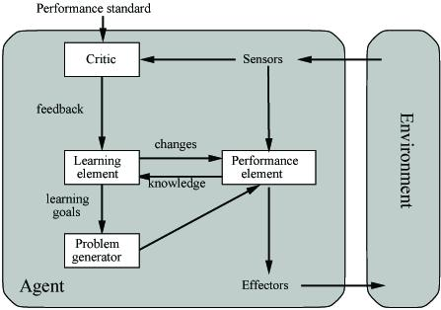
A General Model of Learning Agents
Learning Element
Adds knowledge, makes improvement to system
Performance Element
Performs task, selects external actions
Critic
Monitors results of performance, provides feedback to learning element
Problem Generator
Actively suggests experiments, generates examples to test
Performance Standard
Method / standard of measuring performance

Slide 5
The Learning Problem
Learning = Improving with experience at some task
Improve over task T
With respect to performance measure P
Based on experience E
Example: Learn to play checkers (Chinook)
T: Play checkers
P: % of games won in world tournament
E: opportunity to play against self
Example: Learn to Diagnose Patients
T: Diagnose patients
P: Percent of patients correctly diagnosed
E: Pre-diagnosed medical histories of patients

Slide 6
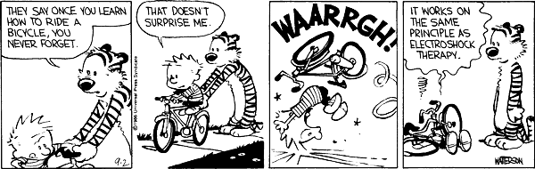
Categories of Learning
Learning by being told
Learning by examples / Supervised learning
Learning by discovery / Unsupervised learning
Learning by experimentation / Reinforcement learning
Syskill and Webert Perform Web Page Rating
Example of supervised learning
Example of supervised learning
Example of unsupervised learning

Slide 7
Learning From Examples
Learn general concepts or categories from examples
Learn a task (drive a vehicle, win a game of backgammon)
Examples of objects or tasks are gathered and stored in a database
Each example is described by a set of attributes or features
Each example used for training is classified with its correct label (chair, not chair, horse, not horse, 1 vs. 2 vs. 3, good move, bad move, etc.)
The machine learning program learns general concept description from these specific examples
The ML program should be applied to classify or perform tasks never before seen from learned concept

Slide 8
Learning From Examples
First algorithm: naïve Bayes classifier
D is training data
Each data point is described by attributes a₁..a_{n}
Learn mapping from data point to a class value
Class values v₁..v_{j}
We are searching through the space of possible concepts
Functions that map data to class value

Slide 9
Supervised Learning Algorithm – Naïve Bayes
For each hypothesis , calculate the posterior probability
Output the hypothesis h_{MAP} (maximum a posteriori hypothesis)
with the highest posterior probability

Slide 10
NBC Definition
Assume target function is f:D->V, where each instance d is described by attributes <a₁, a₂, .., a_{n}>. The most probable value of f(d) is

Slide 11
NB Assumption
Assume that the attributes are independent with respect to the class. The result is
which yields the NBC

Slide 12
Using NBC
Training
For each target value (class value) v_{j} estimate P(v_{j})
For each attribute value a_{i} of each attribute a estimate P(a_{i}|v_{j})
Classify new instance

Slide 13
PlayTennis Training Examples
Day | Outlook | Temperature | Humidity | Wind | PlayTennis
D1 | Sunny | Hot | High | Weak | No
D2 | Sunny | Hot | High | Strong | No
D3 | Overcast | Hot | High | Weak | Yes
D4 | Rain | Mild | High | Weak | Yes
D5 | Rain | Cool | Normal | Weak | Yes
D6 | Rain | Cool | Normal | Strong | No
D7 | Overcast | Cool | Normal | Strong | Yes
D8 | Sunny | Mild | High | Weak | No
D9 | Sunny | Cool | Normal | Weak | Yes
D10 | Rain | Mild | Normal | Weak | Yes
D11 | Sunny | Mild | Normal | Strong | Yes
D12 | Overcast | Mild | High | Strong | Yes
D13 | Overcast | Hot | Normal | Weak | Yes
D14 | Rain | Mild | High | Strong | No

Slide 14
PlayTennis Example
Target values are Yes and No
Assume examples 1-12 comprise training data
P(Yes) = 8/12, P(No) = 4/12
Now we want to determine class for example 13 (Outlook=Overcast, Temperature=Hot, Humidity=Normal, Wind=Weak)
Determine which value is larger
P(Yes)*P(Overcast|Yes)*P(Hot|Yes)*P(Normal|Yes)*P(Weak|Yes)
= 8/12 * 2/8 * 1/8 * 5/8 * 5/8 = 0.00814
P(No)*P(Overcast|No)*P(Hot|No)*P(Normal|No)*P(Weak|No)
= 4/12 * 0 * 2/4 * 1/4 * 2/4 = 0.0
Answer is Yes

Slide 15
NBC Subtleties
Conditional independence is often violated...
...but it works surprisingly well anyway. We do not need the actual probability, just the class that yields the largest value.
Some attribute values may not appear in any training examples.
Use small non-zero value

Slide 16
NBC For Text Classification
Uses
Filter spam
Classify web pages by topic
Categorize email
NBC is very effective for this application.
What attributes shall we use?
Do we care about word position?
Joachims performed experiment with 20 newsgroups, 1000 articles per class, 2/3 training 1/3 testing, achieved 89% accuracy

Slide 17

Prediction Problems
Customer purchase behavior

Slide 18
Prediction Problems
Customer retention

Slide 19
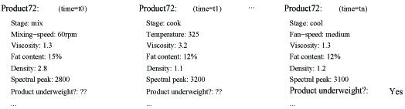
Prediction Problems

Slide 20
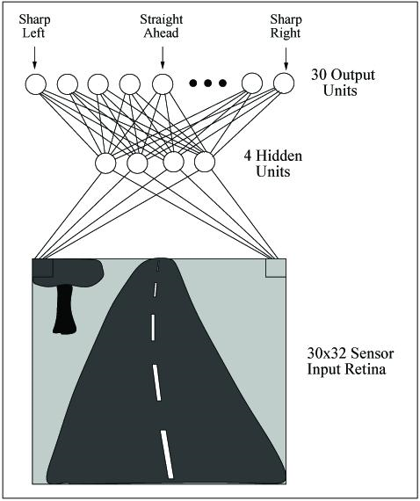
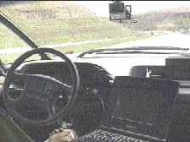

Prediction Problems
Problems too difficult to program by hand

Slide 21
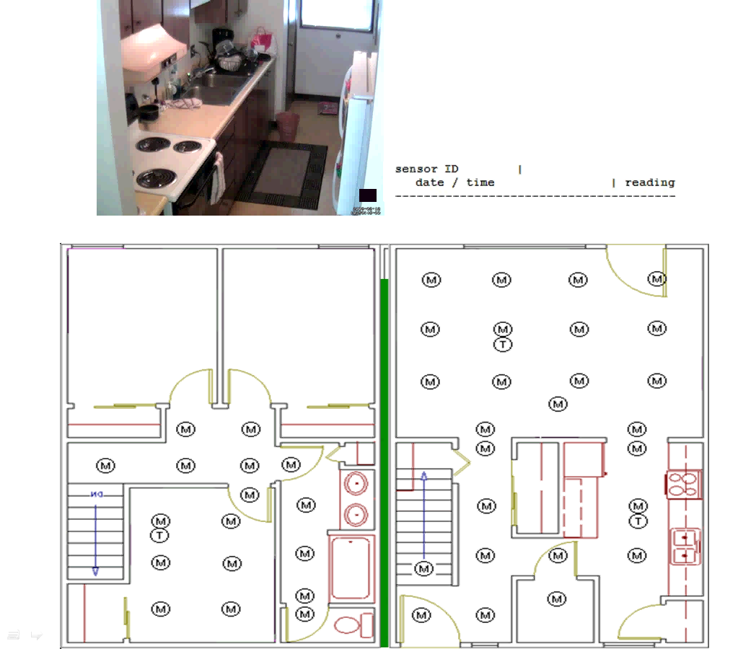
Identify
Sense
Identify
Assess
Remind
Assist

Slide 22

Prediction Problems
Software that customizes to user

Slide 23
Inductive Learning Hypothesis
Any hypothesis found to approximate the target function well over a sufficiently large set of training examples will also approximate the target function well over other unobserved examples

Slide 24
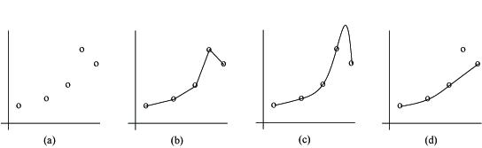
Inductive Bias
There can be a number of hypotheses consistent with training data
Each learning algorithm has an inductive bias that imposes a preference on the space of all possible hypotheses

Slide 25
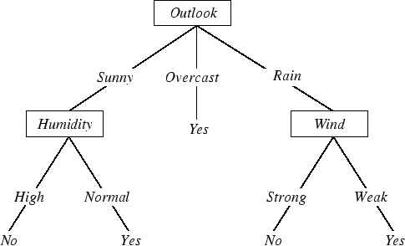
Decision Trees
A decision tree takes a description of an object or situation as input, and outputs a yes/no "decision".
Can also be used to output greater variety of answers.
Here is a decision tree for the concept PlayTennis

Slide 26
Decision Tree Representation
Each internal node tests an attribute
Each branch corresponds to attribute value
Each leaf node assigns a classification

Slide 27
When to Consider Decision Trees
Instances describable by attribute-value pairs
Target function is discrete valued
Disjunctive hypothesis may be required
Possibly noisy training data

Slide 28
Inducing Decision Trees
Each example is described by the values of the attributes and the value of the goal predicate (Yes/No)
The value of the goal predicate is called the classification of the example
If the classification is true (Yes), this is a positive example, otherwise this is a negative example
The complete set of examples is called the training set

Slide 29
Decision Tree Learning
Any concept that can be expressed as a propositional statement can be expressed using a decision tree
No type of representation is efficient for all kinds of functions How represent of m of n?
Once we know how to use a decision tree, the next question is, how do we automatically construct a decision tree?
One possibility: search through the space of all possible decision trees
All possible n features at root
For each root, n-1 possible features at each child
…
Keep the hypotheses that are consistent with training examples
Among these, keep one that satisfies bias
Too slow!
Another possibility: construct one path for each positive example
Not very general
Another possibility: find smallest decision tree consistent with all examples
Inductive Bias: Ockham's Razor

Slide 30
Top-Down Induction of Decision Trees
At each point, decide which attribute to use as next test in the tree
Attribute splits data based on answer to question
Each answer forms a separate node in decision tree
Each node is the root of an entire sub-decision tree problem, possibly with fewer examples and one fewer attribute than its parent

Slide 31
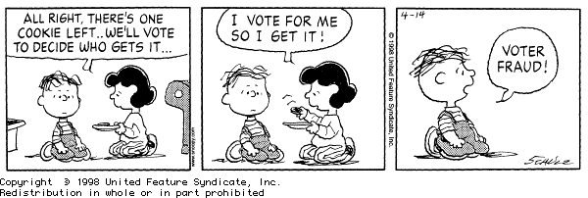
Four Cases To Consider
If both + and -, choose best attribute to split
If all + (or -), then we are done
If no examples, no examples fit this category, return default value (calculate using majority classification from parent)
If no attributes left, then there are inconsistencies, called noise
We can use a majority vote to label the node.

Slide 32

Which Attribute Is Best?
Pick one that provides the highest expected amount of information
Information Theory measures information content in bits
One bit of information is enough to answer a yes/no question about which one has no idea

Slide 33
Entropy
S is a sample of training examples
p₊ is the proportion of positive examples in S
p₋ is the proportion of negative examples in S
Entropy measure the impurity of S
Entropy(S) = expected #bits needed to encode class (+ or -) of randomly drawn element of S (using optimal, shortest-length code)

Slide 34
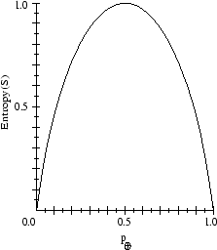
Entropy
Information theory: optimal length code assigns –log₂p bits to message of probability p
Expected number of bits to encode + or – of random element of S
p₊(-log₂p₊) + p₋(-log₂p₋)
Entropy(S) = -p₊log₂p₊ - p₋log₂p₋

Slide 35
Information Content
Entropy is also called the information content I of an actual answer
Suppose you are sending messages to someone, could send several possible messages. How many bits are needed to distinguish which message is being sent?
If P(message) = 1.0, don't need any bits (pure node, all one class).
For other probability distributions, use shorter encodings for higher-probability classes. P = 0.8,0.2 requires fewer bits on average than P = 0.5, 0.5.
Log of a fraction is always negative, so term is multiplied by -1.
If possible answers v_{i} have probabilities P(v_{i}) then the information content I of actual answer is given by
I(1/2, 1/2) = -(1/2 log₂1/2) - (1/2 log₂1/2) = 1 bit
I(0.01, 0.99) = 0.08 bits

Slide 36
Information Theory and Decision Trees
What is the correct classification?
Before splitting, estimate of probabilities of possible answers calculated as proportions of positive and negative examples
If training set has p positive examples and n negative examples, then the information contained in a correct answer is
I((p/p+n), (n/p+n))
Splitting on a single attribute does not usually answer entire question, but it gets us closer
How much closer?

Slide 37
Information Gain
Gain(S,A) = expected reduction in entropy due to sorting on A
Look at decrease in information of correct answer after split

Slide 38
Training Examples
Day | Outlook | Temperature | Humidity | Wind | PlayTennis
D1 | Sunny | Hot | High | Weak | No
D2 | Sunny | Hot | High | Strong | No
D3 | Overcast | Hot | High | Weak | Yes
D4 | Rain | Mild | High | Weak | Yes
D5 | Rain | Cool | Normal | Weak | Yes
D6 | Rain | Cool | Normal | Strong | No
D7 | Overcast | Cool | Normal | Strong | Yes
D8 | Sunny | Mild | High | Weak | No
D9 | Sunny | Cool | Normal | Weak | Yes
D10 | Rain | Mild | Normal | Weak | Yes
D11 | Sunny | Mild | Normal | Strong | Yes
D12 | Overcast | Mild | High | Strong | Yes
D13 | Overcast | Hot | Normal | Weak | Yes
D14 | Rain | Mild | High | Strong | No

Slide 39
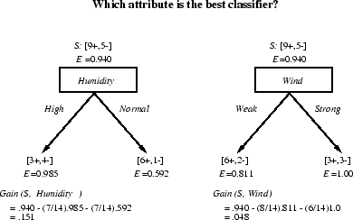
Selecting the Next Attribute

Slide 40
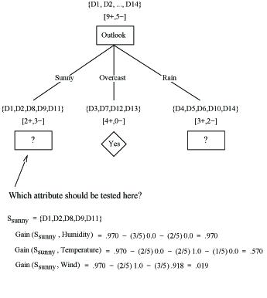
Partially Learned Tree

Slide 41
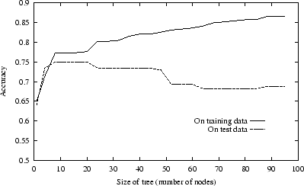
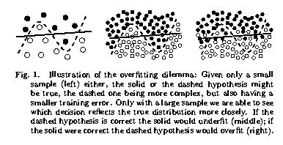
Danger: Overfit
One solution:
prune decision tree

Slide 42
How Do We Prune a Decision Tree?
Delete a decision node
This causes entire subtree rooted at node to be removed
Replace by leaf node, and assign it by majority vote
Reduced error pruning: remove nodes as long as performance improves on validation set

Slide 43
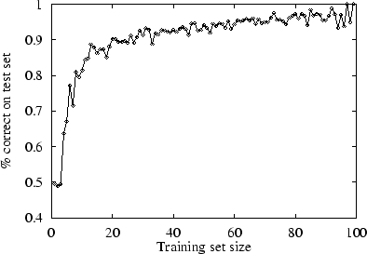
Measure Performance of a Learning Algorithm
Collect large set of examples (as large and diverse as possible)
Divide into 2 disjoint sets (training set and test set)
Learn concept based on training set, generating hypothesis H
Classify test set examples using H, measure percentage correctly classified
Should demonstrate
improved performance as
training set size increases
(learning curve)
How quickly does it learn?

Slide 44
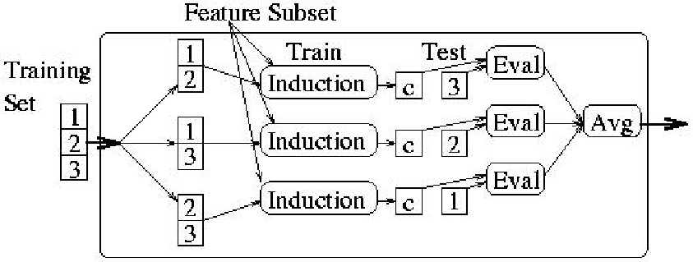
Measure Performance of a Learning Algorithm
Use statistics tests to determine significance of improvement
Cross-validation

Slide 45
Challenges for Decision Trees
Numeric attributes
Missing attribute values
Incremental updating

Slide 46
Training Examples
Day | Outlook | Temperature | Humidity | Wind | PlayTennis
D1 | Sunny | 85 | 85 | Weak | No
D2 | Sunny | 80 | 90 | Strong | No
D3 | Overcast | 83 | 86 | Weak | Yes
D4 | Rain | 70 | 96 | Weak | Yes
D5 | Rain | 68 | 80 | Weak | Yes
D6 | Rain | 65 | 70 | Strong | No
D7 | Overcast | 64 | 65 | Strong | Yes
D8 | Sunny | 72 | 95 | Weak | No
D9 | Sunny | 69 | 70 | Weak | Yes
D10 | Rain | 75 | 80 | Weak | Yes
D11 | Sunny | 75 | 70 | Strong | Yes
D12 | Overcast | 72 | 90 | Strong | Yes
D13 | Overcast | 81 | 75 | Weak | Yes
D14 | Rain | 71 | 91 | Strong | No

Slide 47
Decision Tree
Outlook
sunny
windy
overcast
Humidity
Yes
Windy
<=75
>75
true
false
Yes
No
No
Yes

Slide 48
Performance Measures
Percentage correctly classified, averaged over folds
Confusion matrix
Accuracy = (TP+TN) / (TP+FP+TN+FN)
Error = 1 - Accuracy
Precision, Recall, ROC curves
 | Predicted Negative | Predicted Positive
Actual Negative | TN | FP
Actual Positive | FN | TP

Slide 49
Examples
Bet on a basketball team
Build decision tree
Build decision trees

Slide 50
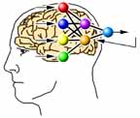
Neural Networks
Instead of traditional vonNeumann machines, researchers wanted to build machines based on the human brain
An architecture as well as a learning technique Connection Machine
The data structure is a network of units that act as "neurons"
Tested as a computing device originally by researchers such as Jon Hopfield (Cal Tech), Hebb (1949), Minsky (1951), and Rosenblatt (1957)
Also models human performance Voice recognition, handwriting recognition, face recognition (traditionally computers bad at these tasks, humans great)

Slide 51
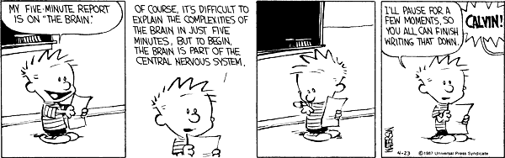
Power In Numbers
Each neuron is not extremely powerful by itself
Neuron switching time is ~ second
Each message 100,000 times slower than a computer switch
10 billion - 1 trillion neurons
Each neuron has 1,000 - 100,000 connections
Computational neural networks are inspired by biology, but do not exactly imitate biology

Slide 52
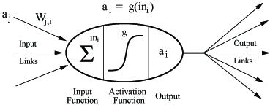
Neuron
A neural network is made up of neurons, or processing elements

Slide 53
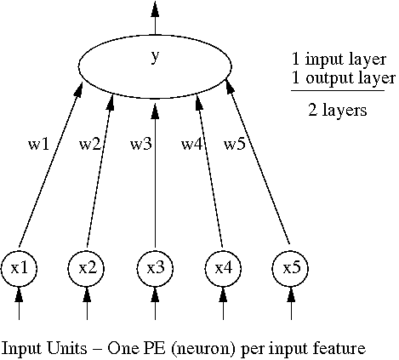
A Simple Neural Network – The Perceptron

Slide 54

Neuron
Each activation value x_{i} is weighted by w_{i}
The output y is determined by the NN transfer function
y = 1 if > Threshold
0 otherwise
This is a step transfer function

Slide 55
Neural Networks Learn a Function
y = function(x₁, x₂, ..., x_{n})
Perceptrons use one input neuron for each input parameter x₁..x_{n}
y is computed using the transfer function applied to values coming in to the output node
Suppose we are trying to learn the concept “all binary strings of length five with a 1 in the first and last positions”
10101 -> 1 10100 -> 0
5 input units, 1 output unit Input units are assigned value 0 or 1 In this case, output is 0 or 1
Input units are always assigned a value If we need symbolic inputs, can map to numeric inputs (convert to binary)
f(2 legs, brown, flat, 3' high) = chair

Slide 56
Applications
Handwriting recognition
Control problems
Autonomous navigation
Stock market prediction
Image recognition
Alvinn drives 70 mph on highways
Alvinn in action

Slide 57
When To Consider Neural Networks
Input is high-dimensional discrete or real-valued (e.g. raw sensor input)
Output is discrete or real valued
Output is a vector of values
Possibly noisy data
Form of target function is unknown
Human readability of result is unimportant

Slide 58
Two Computation Phases
Training phase
Testing / use phase
During training, run perceptron on examples and compare network output (y) to desired output (y^{d})
Weights are adjusted after each training step using function
Optionally, the threshold can be adjusted as well using function
Notice that x is the value of the input feature, thus weights are changed ONLY for nodes that are activated (used in the computation)

Slide 59
Parameters That Can Affect Performance
Initial weights (can be initialized to 0, usually better if randomly set)
Initial threshold, y = 1 if
Transfer function
Learning rate,
Threshold update function
Number of epochs

Slide 60
Code
Perceptron code
Example

Slide 61
Learn Logical AND of x1 and x2
Initially let w1=0, w2=0, T=0, eta=1
Epoch 1
x1 | x2 | y^{d}
0 | 0 | 0
0 | 1 | 0
1 | 0 | 0
1 | 1 | 1
x1 | x2 | w1^{old} | w2^{old} | T^{old} | y | y^{d} | w1^{new} | w2^{new} | T^{new}
0 | 0 | 0 | 0 | 0 | 0 | 0 | 0 | 0 | 0
0 | 1 | 0 | 0 | 0 | 0 | 0 | 0 | 0 | 0
1 | 0 | 0 | 0 | 0 | 0 | 0 | 0 | 0 | 0
1 | 1 | 0 | 0 | 0 | 0 | 1 | 1 | 1 | -1

Slide 62
Learn Logical AND of x1 and x2
Epoch 2
x1 | x2 | y^{d}
0 | 0 | 0
0 | 1 | 0
1 | 0 | 0
1 | 1 | 1
x1 | x2 | w1^{old} | w2^{old} | T^{old} | y | y^{d} | w1^{new} | w2^{new} | T^{new}
0 | 0 | 1 | 1 | -1 | 1 | 0 | 1 | 1 | 0
0 | 1 | 1 | 1 | 0 | 1 | 0 | 1 | 0 | 1
1 | 0 | 1 | 0 | 1 | 0 | 0 | 1 | 0 | 1
1 | 1 | 1 | 0 | 1 | 0 | 1 | 2 | 1 | 0

Slide 63
Learn Logical AND of x1 and x2
Epoch 3
x1 | x2 | y^{d}
0 | 0 | 0
0 | 1 | 0
1 | 0 | 0
1 | 1 | 1
x1 | x2 | w1^{old} | w2^{old} | T^{old} | y | y^{d} | w1^{new} | w2^{new} | T^{new}
0 | 0 | 1 | 1 | 0 | 0 | 0 | 2 | 1 | 0
0 | 1 | 1 | 1 | 0 | 1 | 0 | 2 | 0 | 1
1 | 0 | 2 | 0 | 1 | 1 | 0 | 1 | 0 | 2
1 | 1 | 1 | 0 | 2 | 0 | 1 | 2 | 1 | 1

Slide 64
Learn Logical AND of x1 and x2
Epoch 4
x1 | x2 | y^{d}
0 | 0 | 0
0 | 1 | 0
1 | 0 | 0
1 | 1 | 1
x1 | x2 | w1^{old} | w2^{old} | T^{old} | y | y^{d} | w1^{new} | w2^{new} | T^{new}
0 | 0 | 2 | 1 | 1 | 0 | 0 | 2 | 1 | 1
0 | 1 | 2 | 1 | 1 | 0 | 0 | 2 | 1 | 1
1 | 0 | 2 | 1 | 1 | 1 | 0 | 1 | 1 | 2
1 | 1 | 1 | 1 | 2 | 0 | 1 | 2 | 2 | 1

Slide 65
Learn Logical AND of x1 and x2
Epoch 5
x1 | x2 | y^{d}
0 | 0 | 0
0 | 1 | 0
1 | 0 | 0
1 | 1 | 1
x1 | x2 | w1^{old} | w2^{old} | T^{old} | y | y^{d} | w1^{new} | w2^{new} | T^{new}
0 | 0 | 2 | 2 | 1 | 0 | 0 | 2 | 1 | 1
0 | 1 | 2 | 2 | 1 | 1 | 0 | 2 | 1 | 2
1 | 0 | 2 | 1 | 2 | 0 | 0 | 2 | 1 | 2
1 | 1 | 2 | 1 | 2 | 1 | 1 | 2 | 1 | 2

Slide 66
Learn Logical AND of x1 and x2
Epoch 6
x1 | x2 | y^{d}
0 | 0 | 0
0 | 1 | 0
1 | 0 | 0
1 | 1 | 1
x1 | x2 | w1^{old} | w2^{old} | T^{old} | y | y^{d} | w1^{new} | w2^{new} | T^{new}
0 | 0 | 2 | 1 | 2 | 0 | 0 | 2 | 1 | 2
0 | 1 | 2 | 1 | 2 | 0 | 0 | 2 | 1 | 2
1 | 0 | 2 | 1 | 2 | 0 | 0 | 2 | 1 | 2
1 | 1 | 2 | 1 | 2 | 1 | 1 | 2 | 1 | 2
CONVERGENCE!

Slide 67
The AND Function
Notice that the classes can be separated by a line (hyperplane)
Learn XOR of two inputs, x1 and x2
w1=2, w2=1, Threshold=2
Why does the perceptron run forever and never converge?
x2
+ is Class 1
- Is Class 2
-
+
+
+
-
-
+
-
-
+
+
-
+
x1
-
-
+
-
-
+
-
+
-
-
2x1 + x2 = 2

Slide 68
Function Learned By Perceptron
The final network can be expressed as an equation of the parameters x₁ through x_{n}
w₁ x₁ + w₂ x₂ + ... + w_{n} x_{n} = Threshold
If learned, the network can be represented as a hyperplane
x2
w₁x₁ + w₂x₂ + … + w_{n}x_{n} = t
+ is Class 1
- Is Class 2
+
+
+
-
-
+
+
+
-
-
-
+
-
x1
+
+
-
-
-
+
-
-
-

Slide 69
Examples
Perceptron Example
Perceptron Example

Slide 70
Linearly Separable
If the classes can be separated by a hyperplane, then they are linearly separable.
Linearly Separable Learnable by a Perceptron
Here is the XOR space:
No line can separate these data points
into two classes – need two lines
+
-
-
+

Slide 71
How Can We Learn These Functions?
Add more layers with more neurons!
Features of perceptrons:
Only 1 neuron in output layer
Inputs only 0 or 1
Transfer function compares weighted sum to threshold
No hidden units
Output is only 0 or 1

Slide 72
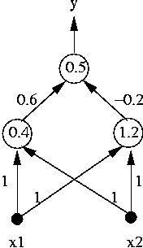
Multilayer Neural Networks
1 input layer (2 units), 1 hidden layer (2 units), 1 output layer (1 unit)
Like before, output is a function of the weighted input to the node

Slide 73
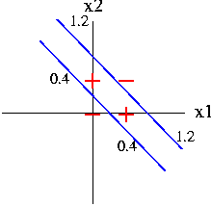
Function Learned by MNN

Slide 74
Learning in a Multilayer Neural Network
How should we change (adapt) the weights in a multilayer neural network?
A perceptron is easy - direct mapping between weights and output.
Here, weights can contribute to intermediary functions and only indirectly affect output. These weights can indirectly affect multiple output nodes.
If output is 12 and we want a 10, change weights to output node so that output next time would be (closer to) desired value 10.
How do we change weights to hidden units?
Assign portion of error to each hidden node, change weights to lessen that error next time.

Slide 75
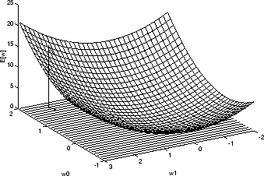
Weight Learning Using Gradient Descent

Slide 76


Deriving an Update Function
Our goal is to reduce error (often sum of squared errors), which is
Since the gradient specifies direction of steepest increase of error, the training rule for gradient descent is to update each weight by the derivative of the error with respect to each weight, or
The derivative of a particular weight is
where g’(in) is the derivative of the transfer function & a_{j} is the activation value at source node j.
We want to eliminate the error when we adjust the weights, so we multiply the formula by -1.
We want to constrain the adjustment, so we multiply the formula again by the learning rate .
The result is the Delta Rule.

Slide 77

Delta Rule
Weight update for hidden-to-output links:
w_{ji} = Weight of link from node j to node i
= Learning rate, eta
a_{j} = Activation of node j (output of hidden node j or input for input node j)
Err_{i} = Error at this node (target minus actual output,
total weight change needed to node i)
g’(in_{i}) = Derivative of the transfer function g
Same general idea as before. If error is positive, then network output is too small so weights are increased for positive inputs and decreased for negative inputs. The opposite happens when the error is negative.

Slide 78

Hidden-to-output Weights
Let = represent the error term
=
t_{i} = true / target output for node i
o_{i} = actual / calculated output for node i
in_{i} = sum of inputs
g’ = derivative of the transfer function

Slide 79


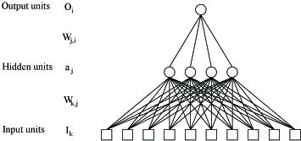
Next Layer
For input-to-hidden weights, we need to define a value analogous to the error term for output nodes. Here we perform error backpropagation. Each hidden node is assigned a portion of the error corresponding to its contribution to the output node.
The formula
Assigns a portion of the responsibility to node j
The proportion is determined by the weight from j to all output nodes. Now we can give the weight update rule for links from input to hidden nodes.
For each input node k to hidden node j use

Slide 80
Update Function
Why use the derivative of the transfer function in the calculation of delta?
Note the visualization of the weight space using gradient descent.
We want to move the weights in the direction of steepest descent in this space.
To do this, compute derivative of the error with respect to each weight in the equation. This results in the delta terms showed earlier.
Note that the transfer function must be differentiable everywhere.

Slide 81
Step Function
Our perceptron transfer function will not work
derivative = infinity here

Slide 82
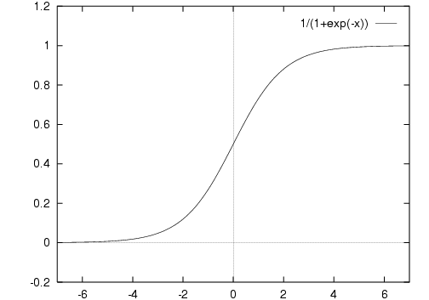
Sigmoid Function
where x is weighted sum of inputs
The sigmoid function is handy to use for backpropagation because
its derivative is easily computed as g(x)*(1-g(x)).

Slide 83



Sigmoid Update formula
To calculate output, for each node in network
Calculate weighted sum of inputs,
Compute output or activation of node,
For each node i in output layer
For each node j in lower layers
Update weight w_{ji} by

Slide 84
NN Applications - NETtalk
Sejnowski and Rosenburg, 1985
Written English text to English speech
Based on DECtalk expert system
Look a a window of 7 characters:
Decide how to utter middle character
1 network
1 hidden layer
203 input units (7 character window * 29 possible characters)
80 hidden units
Approximately 30 output units
Demo
T H I S I S (A-Z, “,”, “.” “ “)

Slide 85
Examples
Handwriting Recognition
Balancing Ball
Learn 3D Map

Slide 86
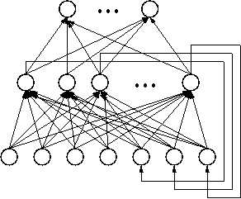
Networks That Deal With Time
In the feedforward networks we have been studying, transfer functions capture the network state (not usually spatiotemporal in nature).
Recurrent neural networks feed signal back from output to network (output to hidden, hidden to hidden, hidden to input, others).
In this way they can learn a function of time.
y(t) = w1 x1(t) + w2 x2(t) + ... + wn+1 x1(t-1) + wn+1 x2(t-1) + ...

Slide 87
Neural Network Issues
Usefulness
Generalizability
Understandability (cannot explain results)
Self-structuring neural networks Add/delete nodes and links until error is minimized
Networks and expert systems Can we learn rules corresponding to network?
Input background knowledge Predefined structure, weights
Computational complexity Blum and Rivest in 1992 proved that training even a three-node network is NP Complete
Inductive bias is smooth interpolation between data points

Slide 88
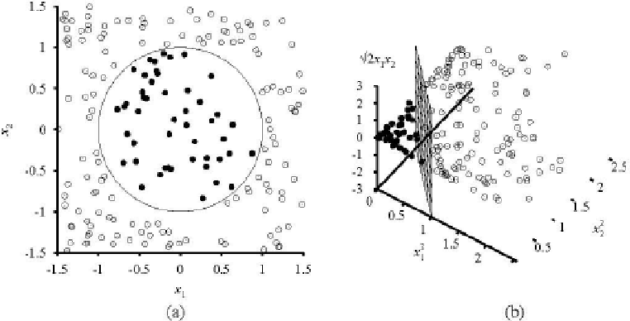

Extending the Idea of Linear Separability
No plane separates examples on the left
We can, however, map the figures onto three new features
and the data in the new space is separable as shown on the right.
We can search for such mappings that leave maximal margins between classes. This is learning using support vector machines .

Slide 89
Reinforcement Learning
Learn action selection for probabilistic applications
Robot learning to dock on battery charger
Learning to choose actions to optimize factory output
Learning to play Backgammon
Note several problem characteristics:
Delayed reward
Opportunity for active exploration
Possibility that state only partially observable
Possible need to learn multiple tasks with same sensors/effectors

Slide 90
Reinforcement Learning
Learning an optimal strategy for maximizing future reward
Agent has little prior knowledge and no immediate feedback
Action credit assignment difficult when only future reward
Two basic agent designs
Agent learns utility function U(s) on states
Used to select actions maximizing expected utility
Requires a model of action outcomes (T(s,a,s'))
Agent learns action-value function
Gives expected utility Q(s,a) of action a in state s
Q-learning Q(s,a)
No action outcome model, but cannot look ahead
Can handle deterministic or probabilistic state transitions

Slide 91
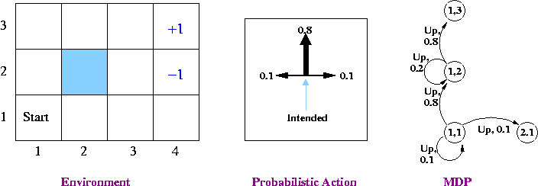
Passive Learning in a Known Environment
P(intended move) = 0.8, P(right angles to intended move) = 0.1
Rewards at terminal states are +1 and -1, other states have reward of -0.04
From our start position the recommended sequence is [Up, Up, Right, Right, Right]. This reaches the goal with probability 0.8⁵ = 0.32768.
Transitions between states are probabilistic, and are represented as a Markov Decision Process.

Slide 92
Markov Decision Processes
Assume
Finite set of states S (with initial state S₀)
Set of actions A
Transition model T(s,a,s'), which can be probabilistic
At each discrete time agent observes state s in S and chooses action a in A
then receives immediate reward R(s)
and state changes to a’
Markov assumption: Resulting state s’ depends only on current state s (or a finite history of previous states) and action a

Slide 93
Problem Solution
Desirability of moving to a given state s is expressed by a utility value
Utility is not the reward, but an estimate of the award that can be accrued from that state
The policy specifies what the agent should do for every reachable state.
An optimal policy, *, is a policy that selects moves with the highest expected utility .

Slide 94
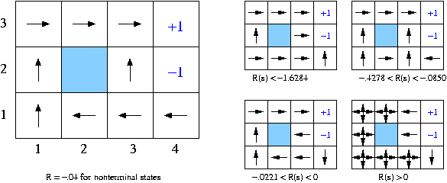
Example Policy
Here is the optimal policy for our example environment.

Slide 95
Define Utility Values
Learn utilities U of each state, pick action that maximizes expected utility of resulting state
Assume infinite horizon
Agent can move an infinite number of moves in the future
With fixed horizon of 3, agent would need to head from (3,1) directly to +1 terminal state
Given a fixed horizon of N, U([s0, s1, .., sN+k]) = U([s0, s1, .., sN])
Reward is accumulated over entire sequence of states
Additive rewards
U_{h}[s₀, s₁, s₂, ..] = R(s₀) + R(s₁) + R(s₂) + …
This could present a problem with infinite horizon problems
Discounted rewards:
is a discount factor
If R is bounded, even for an infinite horizon a discounted reward is finite
In the limit, R will approach

Slide 96

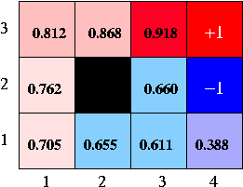
Calculate Utility Values
We will define the utility of a state in terms of the utility of the state sequences that start from the state.
The utility of state using policy is the expected discounted reward for sequence with t steps starting in s
Here are utilities for our navigation problem with =1 and R(s) = -.04 for nonterminal states.

Slide 97


Calculate Utility Values
When selecting an action, the agent choose an action that maximizes the Expected Utility of the resulting state
Because we define utility in terms of immediate reward and (discounted) expected utility of sequences from a state, we can define goodness now as
This is the Bellman equation

Slide 98

Value Iteration
Calculate Bellman equation values incrementally
Iterate until minimal changes
Guaranteed to reach an equilibrium

Slide 99
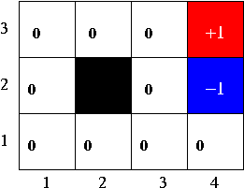
Example

Slide 100
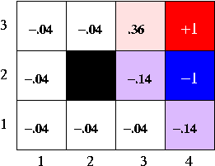
Example

Slide 101
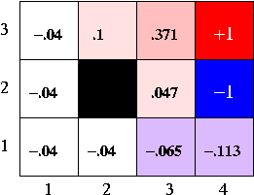
Example

Slide 102
Example
[RN] shows convergence after 30 iterations

Slide 103
Where Does Learning Fit In?
Learn the transition values
Learn the utility values

Slide 104
Adaptive Dynamic Programming
Learn the transition model
When a new state is encountered
Initialize utility to perceived reward for the state
Keep track of N_{sa}[s,a] (number of times action a was executed from state s and N_{sas’}[s,a,s’] (number of times action a was executed from state s resulting in state s’
T[s,a,s’] = N_{sas’}[s,a,s’]/N_{sa}[s,a]
Update utility as before
Solve n equations in n unknowns, n = |states|
Converges slowly

Slide 105
Temporal Difference Learning
Instead of solving equations for all states, incrementally update values only for states that are visited after they are visited
TD reduces discrepancies between utilities of the current and past states
If previous state has utility -100 and current state has utility +100, increase previous state utility to lessen discrepancy
No more need to store explicit model, just need states, visited counts, rewards, and utility values

Slide 106

TD Learning
Temporal difference (TD)
When observe transition from state s to state s’
Set U(s') to R(s') the first time s' is visited
is learning rate
can decrease as number of visits to s increases
(N[s])~1/N[s]
Slower convergence than ADP, but much simpler with less computation

Slide 107
TD Example
3
.19
.46
+1
2
.19
-1
1
-.54
1
2
3
4

Slide 108
Learning an Action-Value Function: Q-Learning
Temporal difference removed the need for a model of transitions
Q learning removes the need for a model of action selection
Assigns value to action/state pairs, not just states
These values are called Q-values Q(a,s)
Q(a,s) = value of performing action a in state s
Learn directly from observed transitions and rewards
Model-free approach
U(s) can be calculated as max_{a}Q(s,a)
TD-based Q learning
When transition from state s to state s’

Slide 109
Example
Q Learning on Grid World
Numbers show Q-value for each action, arrows show optimal action
Rewards of +10 at (9,8), +3 at (8,3), -5 at (4,5), -10 at (4,8)
Probability 0.7 of moving in desired direction, 0.1 of moving in any of other three directions
Bumping into a wall incurs a penalty of 1 (reward of -1) and agent does not move

Slide 110
Examples
TD-Gammon [Tesauro, 1995]
Learn to play Backgammon
Immediate reward
+100 if win
-100 if lose
0 for all other states
Trained by playing 1.5 million games against itself
Now approximately equal to best human player
More about TD-Gammon
Q-Learning applet
TD Learning applied to Tic Tac Toe
Move graphic robot across space
RL applied to channel allocation for cell phones
RL and robot soccer

Slide 111
Subtleties and Ongoing Research
Exploration vs. exploitation
Scalability
Generalize utilities from visited states to other states (inductive learning)
Design optimal exploration strategies
Extend to continuous actions, states

